Slide 1
Network
Network: A Network is a group of two or more computers or other electronic devices that are interconnected for the purpose of exchanging data and sharing resources.
IP Address: An IP address is a unique address that identifies a device on the internet or a local network. IP stands for "Internet Protocol," which is the set of rules governing the format of data sent via the internet or local network.
There are 2 types of IP Addresses. They are
1.Static IP address
2.Dynamic IP address
Static IP Address:A static IP address is a 32 bit number assigned to a computer as an address on the internet.
Dynamic IP Address:It is a temporary address for devices connected to a network that continually changes over time.
DHCP:Dynamic Host Configuration Control
IP Conflict:IP conflict is a term used to denote the state of two or more devices within the same network or subnet that are trying to use the same IP address.

Slide 2
Steps for solving IP Conflict Issue:
Reboot the network
Reboot any system to the devices
IP configuration
IP configuration release
IP configuration renewal
IPV4:The IPv4 address is a 32-bit number that uniquely identifies a network interface on a machine. An IPv4 address is typically written in decimal digits, formatted as four 8-bit fields that are separated by periods.
Max IP Address = 256
IPV6:An IPv6 address is a 128-bit alphanumeric value that identifies an endpoint device in an Internet Protocol Version 6 (IPv6) network.
Standard IP Address = 2^{x}
2^{x}=2^{(32-n)}
x=32-n
n=32-x
Here
n=Value of CIDR

Slide 3
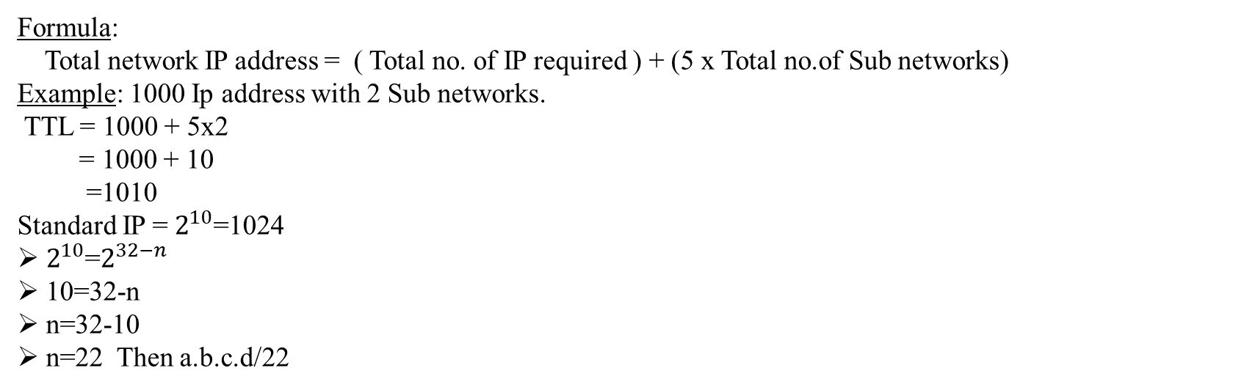
Types of Distribution methods:
Class Full Distribution Method
Class Less Inter Domain Routing (CIDR)
Class Full Distribution Method:
In classful routing, address is divided into three parts which are: Network, Subnet and Host
Class Less Inter Domain Routing (CIDR):
In classless routing, address is divided into two parts which are: Subnet and Host
Formula:
Total network IP address = ( Total no. of IP required ) + (5 x Total no.of Sub networks)
Example: 1000 Ip address with 2 Sub networks.
TTL = 1000 + 5x2
= 1000 + 10
=1010
Standard IP = $2^{10}$=1024
$2^{10}$=$2^{32−n}$
10=32-n
n=32-10
n=22 Then a.b.c.d/22

Slide 4
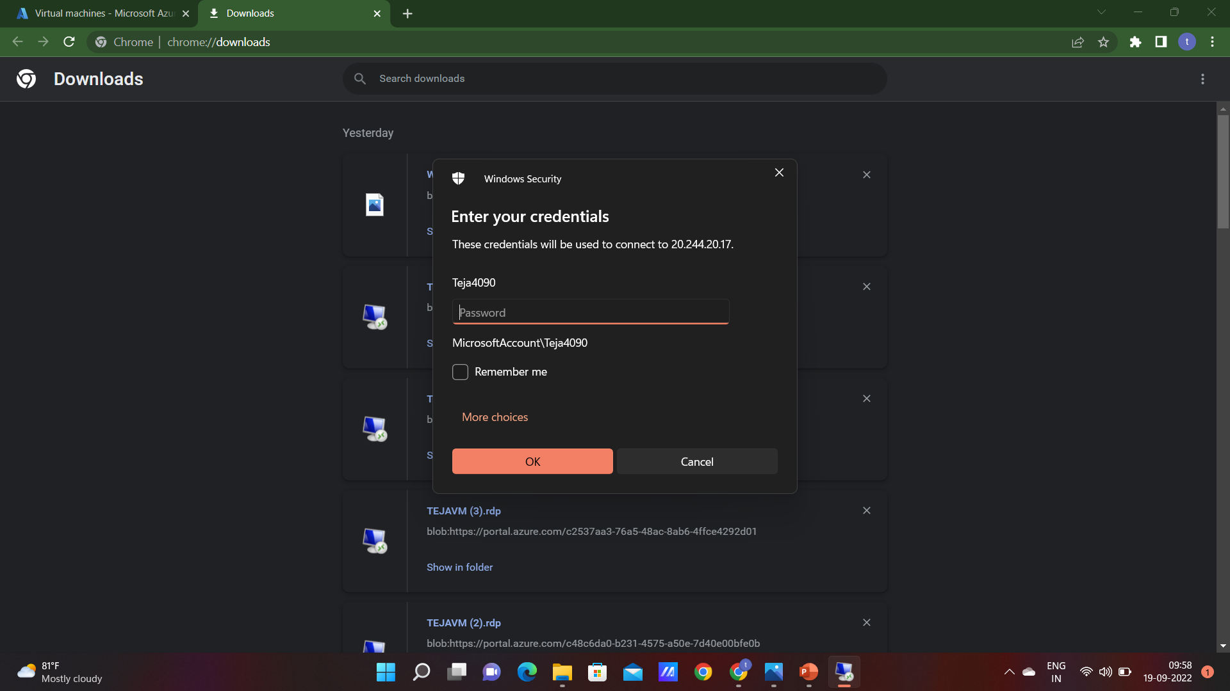
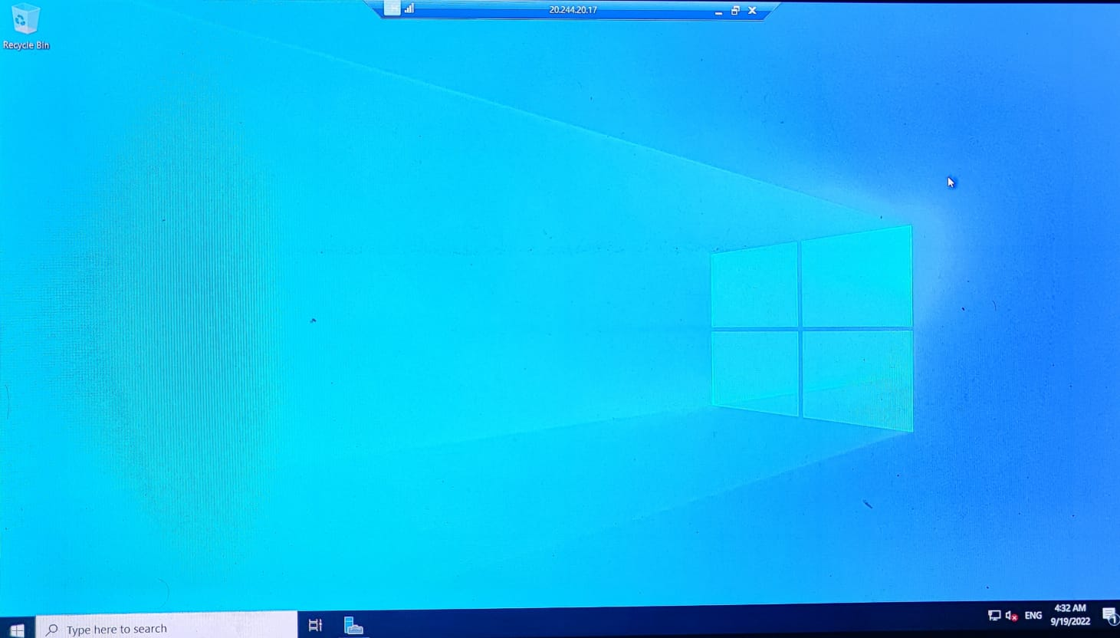
How to create a virtual machine by using RDP
Login to the azure portal
Click create a source
Search virtual machine
Create a virtual machine
Use RDP with port 3389
Creating the windows server
Create VM successfully
Using RDP connect to VM with puvlic IP

Slide 5
Virtual Network
Azure Virtual Network (VNet) is the fundamental building block for your private network in Azure. VNet enables many types of Azure resources, such as Azure Virtual Machines (VM), to securely communicate with each other, the internet, and on-premises networks.
Network Security Group (NSG):
Network Security Group is a access control rules that provide advanced security for Azure virtual machines.
It controls inbound and outbound traffic passing a NIC (Network Interface Card), a virtual machine (classic deployment model), or a subnet(both deployment models)
NIC (Network Interface Card):
NIC is assigned with IP address and associate with NSG Rules , Which is used for the communication between virtual machines or internal network or internet.
Service Endpoints:
It is a feature of virtual network . Which you want to restrict service from a Virtual Network is called Service Endpoints.
Only selected Subnet is access and other Vnet will get restricted from that service.

Slide 6
Virtual Machine:
Virtual Machine are compute instances (machines) in cloud. Where the networking and Hardware's is taken care by the provider.
a virtual machine behaves like a server: It is a computer within a computer that provides the user the same experience they would have on the host operating system itself
1. DISK Size:
Standard HDD
Standard SSD
Primium (I/O’S)
Managed Disk: Managed by Microsoft
Unmanaged Disk: Customer Managed of the storage
2. High Availability:
A high availability cluster is a group of servers that act as a single server to provide continuous uptime. These servers will have access to the same shared storage for data, so if a server is unavailable, the other servers pick up the load.
High Availability Two types in Azure.
1. Availability Set
2. Availability Zone

Slide 7
Availability set:
It is a logical boundary to maintain servers High availability with the help of Fault Domain and Update Domain .
1.Fault Domain :
It is a group of Virtual Machines. Which share common power source and network switch
Each Fault Domain contains some Racks .
Each Rack contain Virtual Machines.
2. Update Domain:
Virtual Machine get update domains automatically once they put inside Availability Set
All the Virtual Machines within that updated Domain will reboot together.
It is used for Patching Virtual Machines

Slide 8
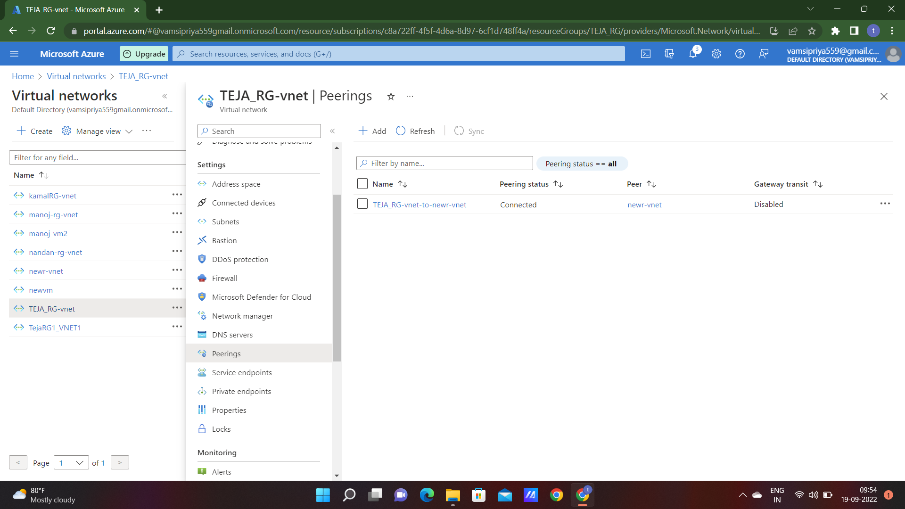
V-net peering
Virtual network peering enables you to seamlessly connect two or more Virtual Networks in Azure. The virtual networks appear as one for connectivity purposes.
The traffic between virtual machines in peered virtual networks uses the Microsoft backbone infrastructure. Like traffic between virtual machines in the same network, traffic is routed through Microsoft’s private network only.

